Slide 1
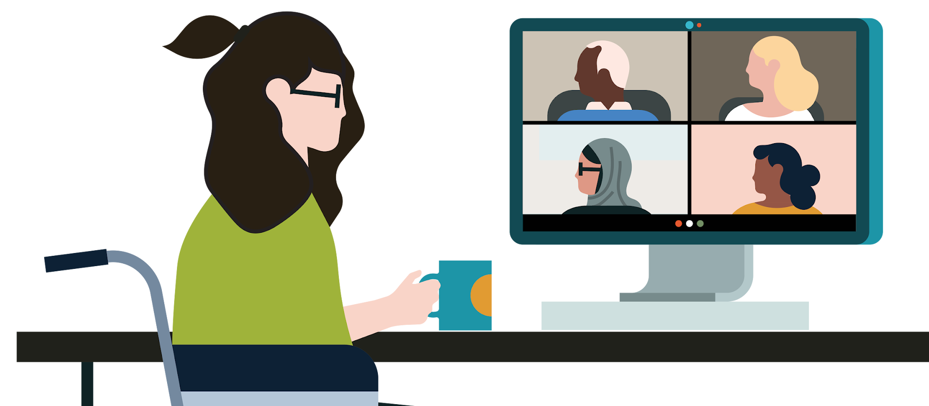

Celebrating Women
Discover new lessons every day which can be completed in around 5-10 minutes. Don’t worry if you miss a day — you can always catch up tomorrow.
Monday | Tuesday | Wednesday | Thursday | Friday
Day 1 Why does gender matter at work (4m 22s) | Day 2 Building empathetic and respectful relationships (3m 20s) | Day 3 Everyday activism (4m 01s) | Day 4 Criticisms are not given equally (2m 40s) | Day 5 What does it mean to be a courageous leader today? (2m 59s)
Day 6 Overcoming gender barriers (4m 12s) | Day 7 Amplifying women’s voices at work (2m 27s) | Day 8 The impact of the racial and gender wage gap (0m 52s) | Day 9 Why today's career model doesn't fit women (2m 48s) | Day 10 Pop Quiz: Overcoming bias in coaching (3m 02s)
Day 11 Use self-awareness to bridge the gap to empathy (4m 14s) | Day 12 Replacing gendered language to be more inclusive (1m 6s) | Day 13 The leadership-likability double bind (3m 47s) | Day 14 Likability bias (2m 02s) | Day 15 Check your bias microaggressions (1m 59s)
Day 16 How to mentor and sponsor women (3m 44s) | Day 17 Office housework (2m 9s) | Day 18 Reinforce DEI lessons for lasting change (1m 19s) | Day 19 Building a gender bilingual organization (4m) | Day 20 Your belonging journey: Last year in review (3m 24s)

